Slide 1
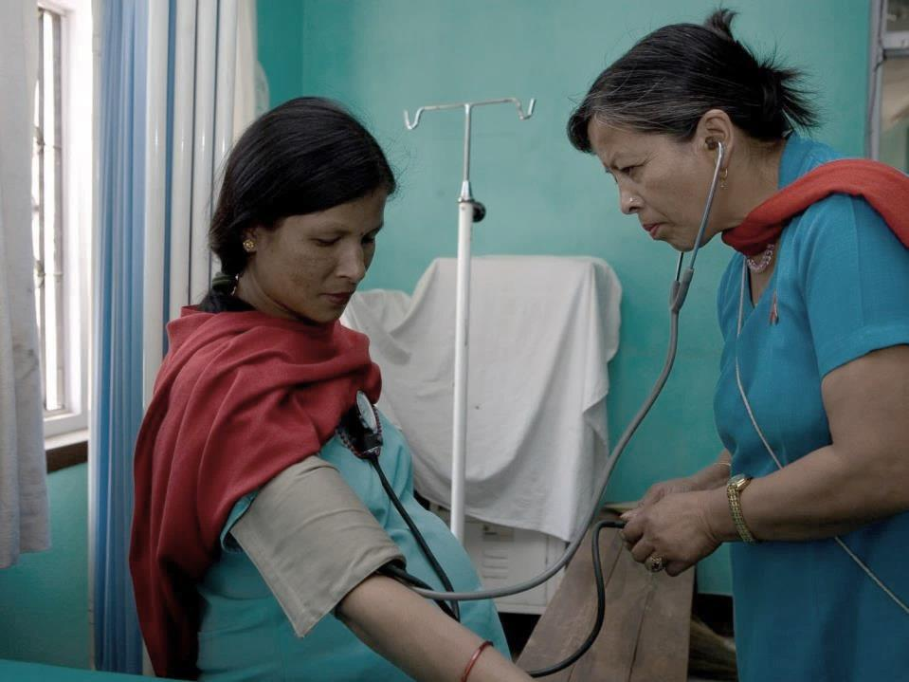
#UNGA #HLM3 #NCDs:
(New York, 27 September 2018)
Svetlana Axelrod
Assistant Director-General
WHO

Slide 2
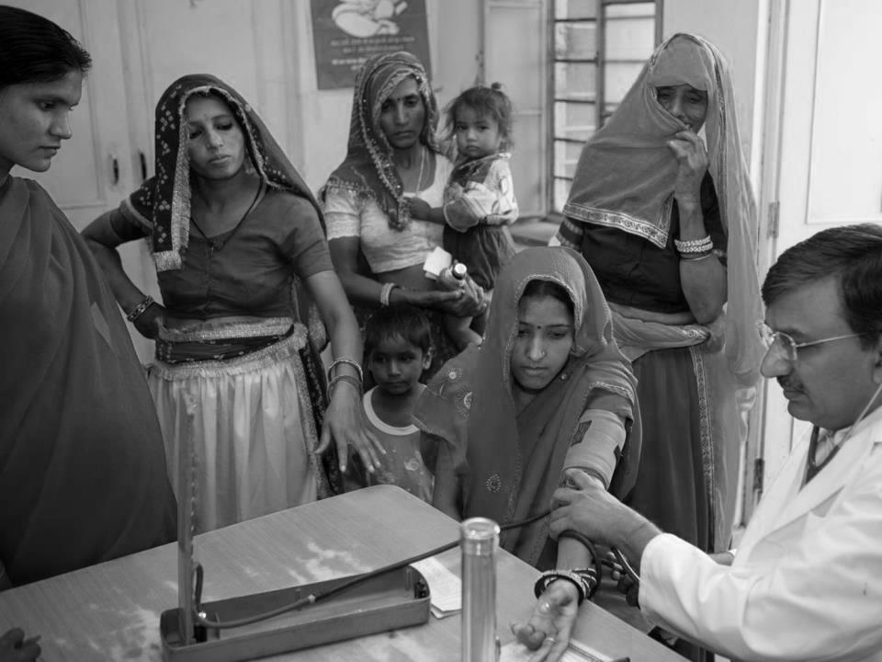
#UNGA #HLM3 #NCDs:
(New York, 27 September 2018)
Douglas Bettcher
Director
WHO

Slide 3
15 million people die each year from NCDs between the ages of 30-70
These 15 million premature deaths can be largely prevented
Communicable, maternal, perinatal and nutritional conditions
NCDs
Injuries

Source: 2015 WHO Global Health Estimates

Slide 4
Huge disparities exist between countries
Probability of dying from any of cardiovascular disease, cancer, diabetes, chronic respiratory disease between the ages of 30 and 70 WHO estimates for 2015 (both sexes)
AFR | Algeria Cabo Verde, Gabon | 15% 16%
AMR | Canada Chile, Costa Rica | 10% 11%
EMR | Qatar Iran (IR) | 14% 15%
EUR | Iceland Italy, Israel, Sweden, Switzerland | 8% 9%
SEAR | Maldives Thailand | 12% 16%
WPR | Republic of Korea Australia, Japan | 8% 9%
AFR | Cote d'Ivoire Sierra Leone | 28% 30%
AMR | Trinidad and Tobago Guyana | 26% 28%
EMR | Sudan Afghanistan, Yemen | 26% 31%
EUR | Belarus, Kazakhstan, Russian Federation, Ukraine Turkmenistan | 29% 35%
SEAR | DPRK Indonesia | 26% 27%
WPR | Fiji Papua New Guinea | 31% 36%

Source: 2015 WHO Global Health Estimates

Slide 5
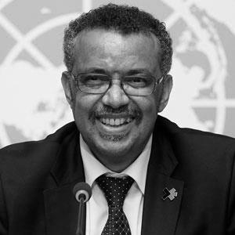
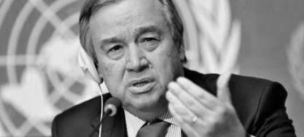
The world is off-track to deliver its commitments on NCDs
Have countries strengthened their capacities to address NCDs since 2011?
Yes
Have there been improvements in NCD health outcomes since 2011?
Yes,
but…
Are we on track to meet the commitments made at the UN General Assembly?
No
Are we on track to meet SDG Target 3.4 (NCDs) by 2030?
No
2018: "The world has yet to fulfil its promise of implementing measures to reduce the risk of dying prematurely from NCDs through prevention and treatment"
2018: "It's crucial to reach agreements on a new strategic course and approach to support countries in implementing the best buys for NCDs"

Slide 6
Outcome indicators
Progress towards the 9 global NCD targets for 2025 | 2010 | 2015 | Trend
Probability of dying between ages of 30 and 70 from one of the mayor NCDs | 20% | 19% | ⬇
Total alcohol per capita consumption within a calendar year (liter) | 6.4 | 6.3 | ⬇
Prevalence of current tobacco smoking use among adults | 23.1% | 21.8% | ⬇
Prevalence of raised blood pressure among adults | 23% | 22% | ⬇
Prevalence of raised blood glucose/diabetes among adults | 8% | 9% | ⬆
Prevalence of obesity in adults | 11% | 13% | ⬆

Slide 7
Process indicators
Percentage of countries with | 2010 | 2015 | Trend
at least one operational multisectoral national NCD action plan | 18% | 37% | ⬆
an operational NCD unit | 53% | 66% | ⬆
an operational policy to reduce the harmful use of alcohol | 48% | 67% | ⬆
an operational policy to reduce physical inactivity | 55% | 72% | ⬆
an operational policy to reduce the burden of tobacco use | 66% | 81% | ⬆
an operational policy to reduce unhealthy diet. | 60% | 74% | ⬆
evidence-based national guidelines for the management of major NCDs through a primary care approach |  | 37%
an operational national policy on NCD-related research |  | 36%
NCD surveillance and monitoring systems in place |  | 29%

Slide 8

Progress indicators for the implementation of national commitments made at UNGA in 2011 and 2014

Slide 9
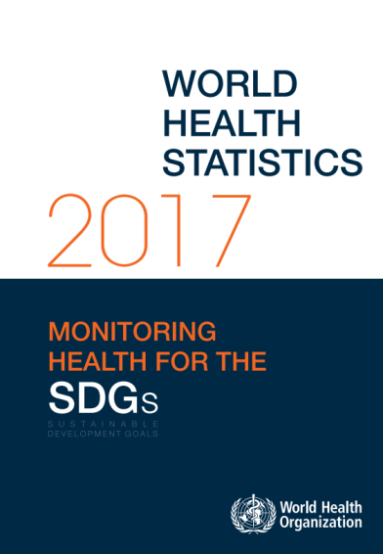
The bottom line
Globally, the probability of dying prematurely from these four main NCDs declined by 17% between 2000 and 2015.
This rate of decline is insufficient to meet the SDG target 3.4 on NCDs (i.e. by 2030, reduce by one third premature mortality from NCDs)
Source: WHO Global Health Estimates

Slide 10
Clarity of vision on how to build national NCD responses
By 2030, reduce by one third premature mortality from NCDs
2030 milestone: NCD-related targets in the SDGs
2025 milestone: 9 voluntary global NCD targets
2018 milestone: Four time-bound commitments
Components of national NCD responses
Governance
Risk factors
Health systems
Surveillance
2011 UN Political Declaration on NCDs
2014 UN Outcome Document on NCDs
WHO Global NCD Action Plan 2013-2020
Best buys and other recommended interventions
Agenda for Sustainable Development
2016-2030

Slide 11

Clarity of vision on what works best
16 best buys, including:
Increase excise taxes and prices on tobacco products
Increase excise taxes on alcoholic beverages
72 good buys, including:
Reduce sugar consumption through effective taxation on sugar-sweetened beverages
www.who.int/ncds/management/best-buys/en/

Slide 12
Obstacles to implementation (WHA71 report on NCDs )
Political choices
Weak links with national SDG responses
Not included in with VNRs at HLPF
Health systems
Lack of access to medicines
Best buys not integrated into PHC and UHC
National capacities
Weak legal capacity,
Lack of capacity to interact with the private sector
International finance
No ODA for NCDs
Demands for technical support cannot be met
Impact of economic, market and commercial factors
Industry interference
Trade promotion to increase exports of health-harming products without supporting countries to develop national NCD responses

Slide 13
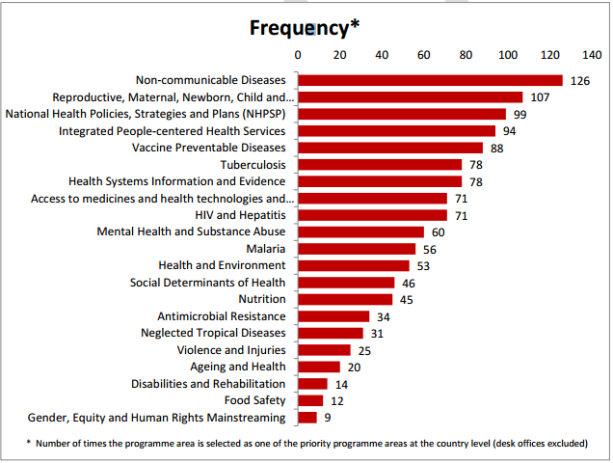
Countries are requesting WHO for support to build NCD responses

Slide 14




WHO is providing technical support through packages

Slide 15
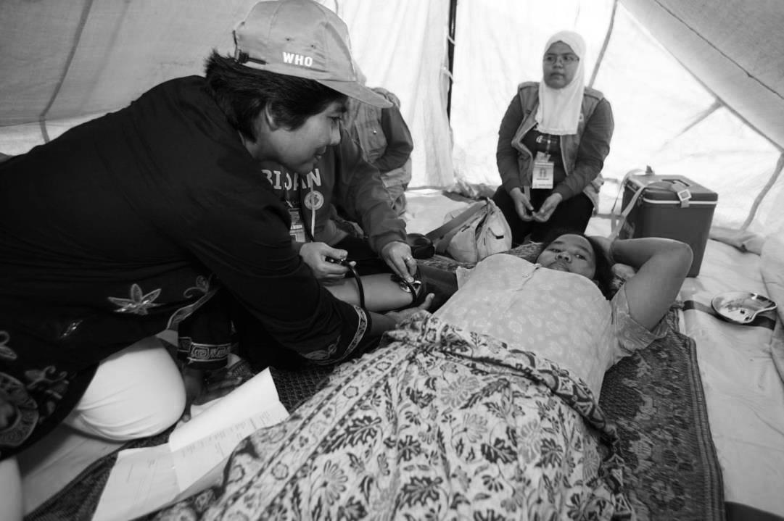
Process moving forward
Etienne Krug
Director
WHO

Slide 16






Commitments made by world leaders to ↓ premature deaths from #NCDs
2018
3rd HLM 
2015
SDGs 
2015
AAAA 

2014 Outcome Document 
2011 Political Declaration 
2011 Moscow Declaration 
2009 ECOSOC Doha Declaration on NCDs
2007 CARICOM Port-of-Spain Declaration on NCDs


.

Slide 17
Preparatory process leading to #HLM3 #NCDs
26 Jan 2018
12 Apr 2018
Formal preparatory process
Co-Facilitators appointed
(Italy and Uruguay)
Modalities resolution for HLM3
5 July 2018
Interactive hearing
Zero draft outcome document
Under the auspices of the President of the UN General Assembly (PGA)

12 Apr 2018

27 Sep HLM3
SG's progress report on NCDs
ESOSOC Progress report Task Force NCDs

18 Oct 2018

Montevideo NCDs Roadmap 2018-2030
Under the auspices of WHO


EB142 report on NCDs
WHO Dialogue on Partnerships and Financing NCDs
WHA71 report on NCDs
WHO Business Case on NCDs
Report of the WHO Independent Commission on NCDs
22-27 Jan 2018
9-11 Apr 2018
21-26 May 2018
20 May 2018
1 June 2018




Informal preparatory process

Slide 18
Possible inputs into the negotiations
Commitments and recommendations:
2011 Political Declaration  and 2014 Outcome Document 
WHO Best buys and other recommended interventions 
UN Secretary-General's report (19 recommendations) 
WHO/Graduate Institute Meeting (18 recommendations) 
Montevideo Roadmap 2018-2030 on NCDs as a sustainable development priority (10 recommendations) 
WHO Global Dialogue on Partnerships for Sustainable Financing of NCDs 
WHO Global Investment Case "Saving Lives, Spending Less" (20 May 2018) 
Report "Time to deliver" of the WHO Independent High-level Commission on NCDs (6 recommendations) 
WHO Think Piece: Why is 2018 important for NCDs? 

Slide 19



Slide 20
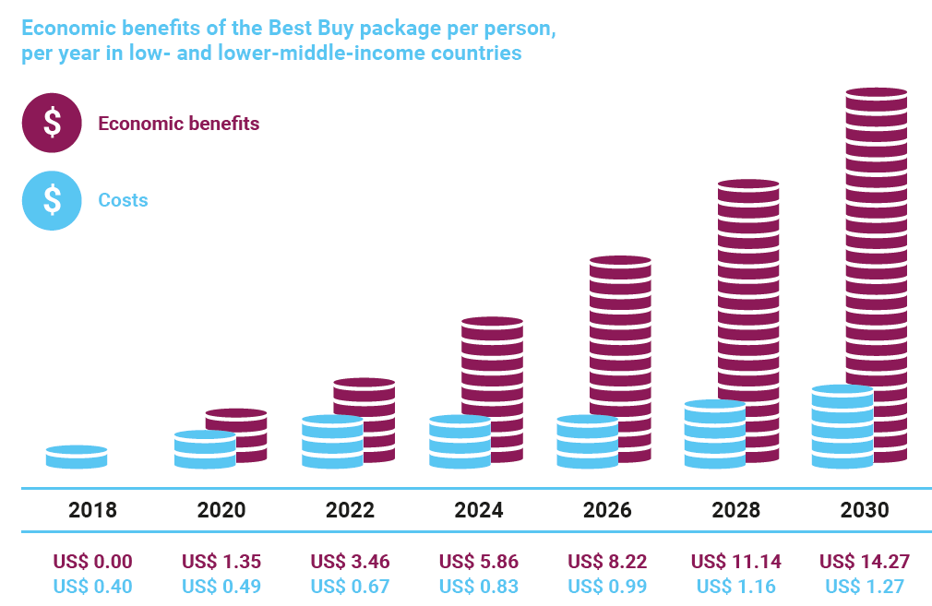
Health impact and economic returns

Slide 21
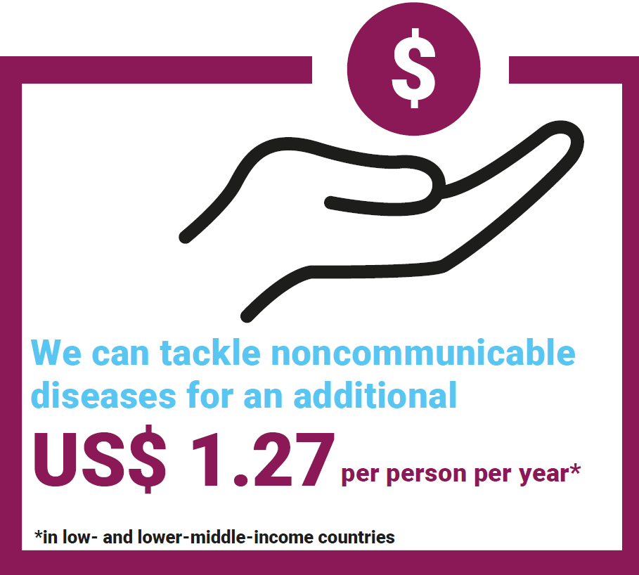

Slide 22
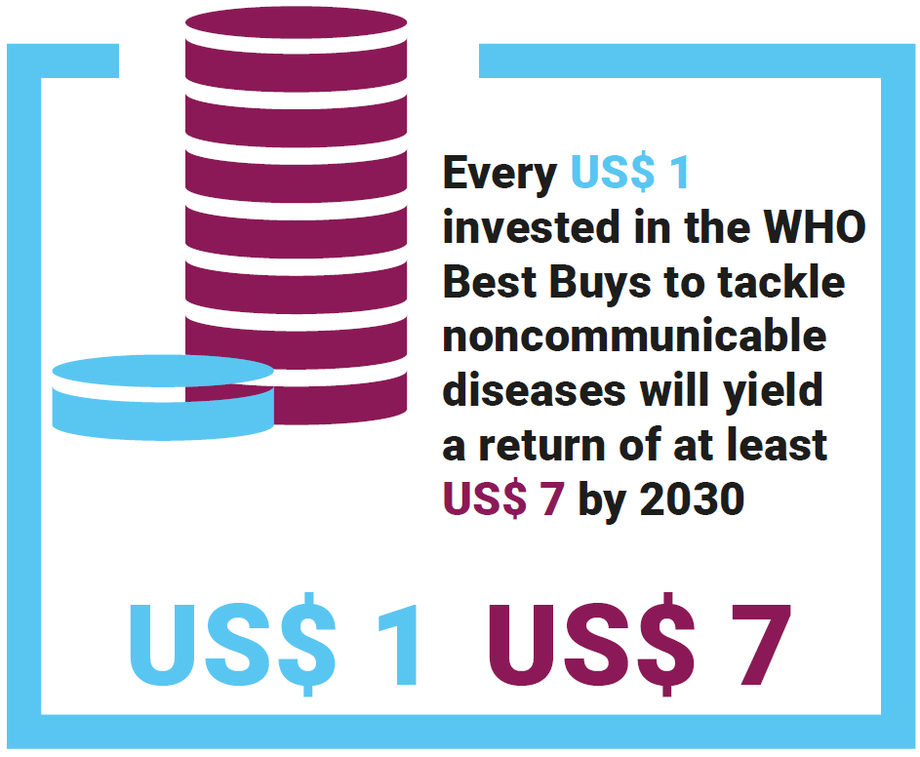

Slide 23
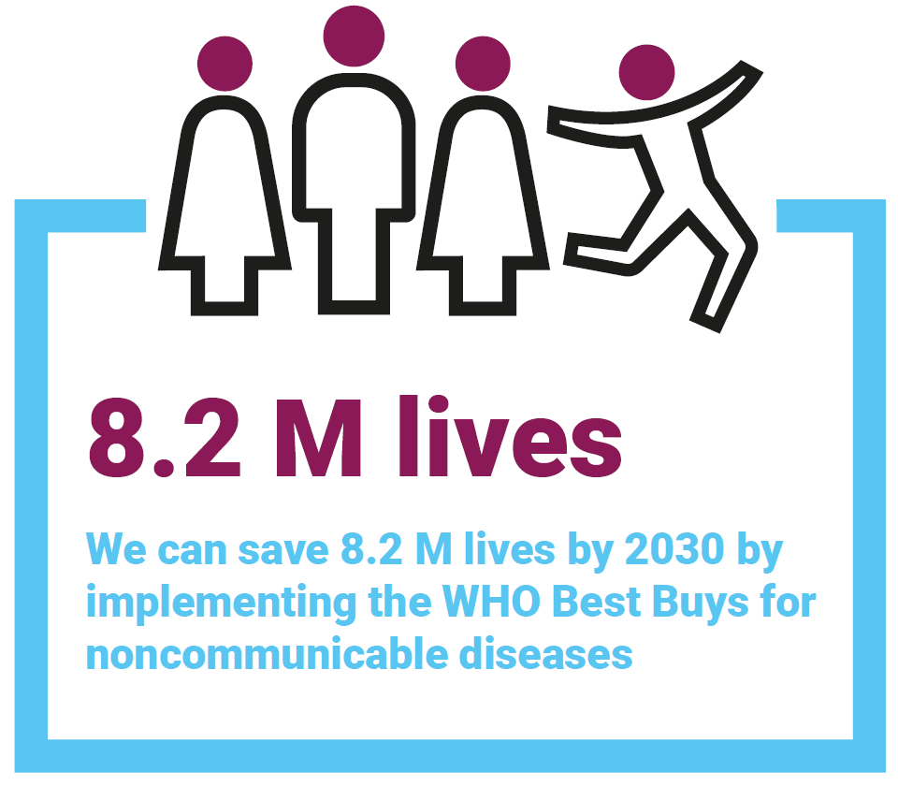

Slide 24
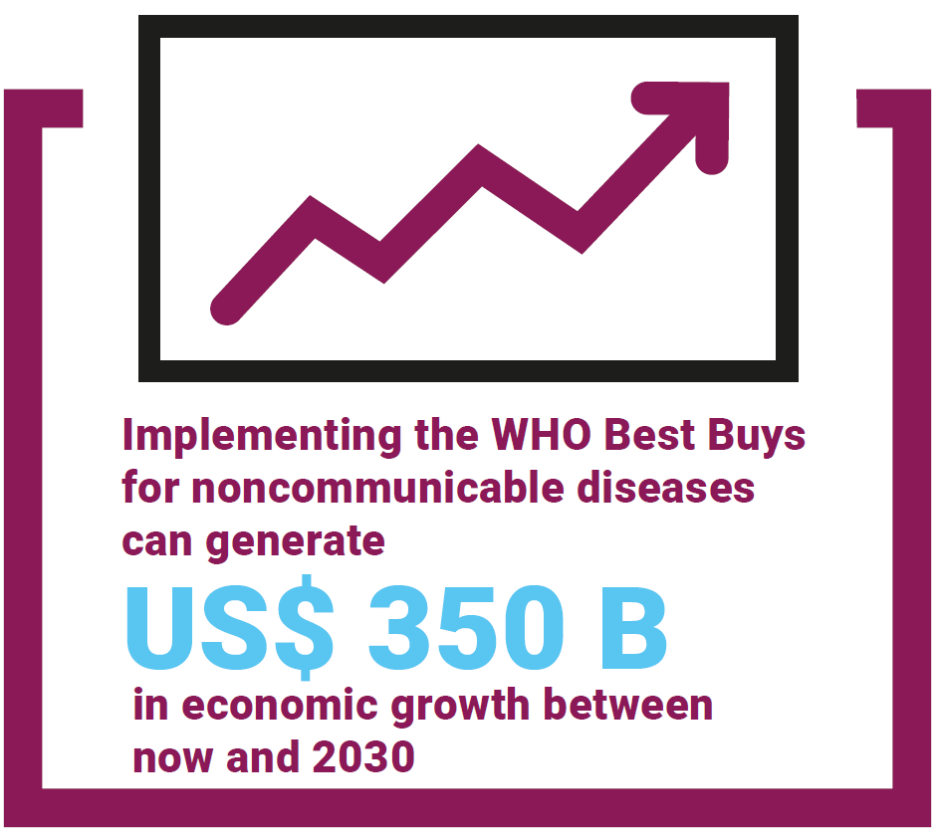

Slide 25
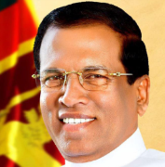
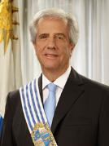
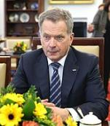
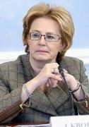

WHO Independent High-level Commission on NCDs
Co-Chairs:
President
Sri Lanka
President
Uruguay
President of
Finland
Minister of Health
Russian Federation
Sania Nishtar
Who?
5 Co-Chairs + 26 Commissioners 
Objectives
Provide the WHO Director-General with bold recommendations on how to transform new opportunities into action that addresses implementation gaps to reach SDG target 3.4 on NCDs.
Why?
New thinking: Report serves as an input into the preparatory process for the third High-level Meeting on NCDs.
New platform: Get Heads of State and Government and Heads of UN Agencies to attend the third High-level Meeting

Slide 26
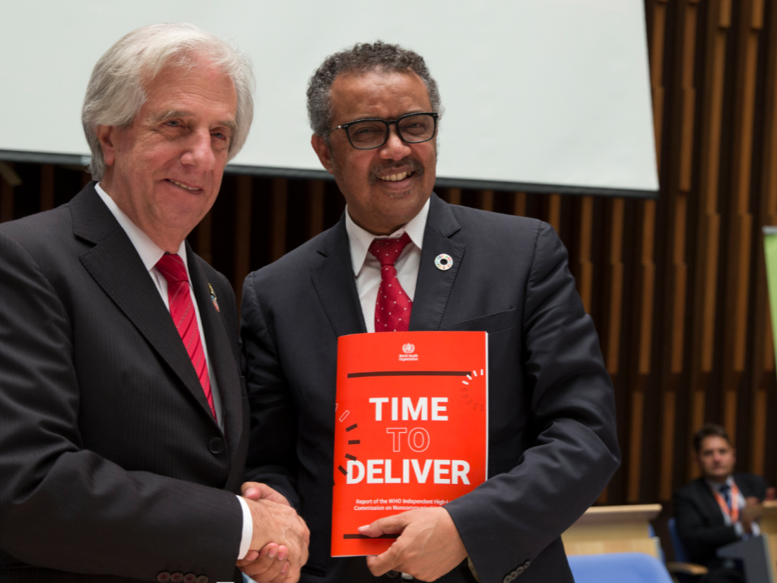
1 June 2018

Slide 27


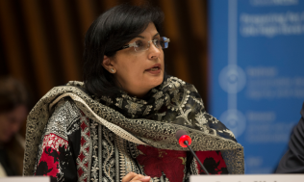
Challenges to implementation:
Lack of political will, commitment, capacity, and action
Lack of policies and plans for NCDs
Difficulties in priority-setting
Impact of economic, commercial, and market factors
Insufficient technical and operational capacity
Insufficient (domestic and international) financing to scale up national NCD responses
Lack of accountability

Slide 28
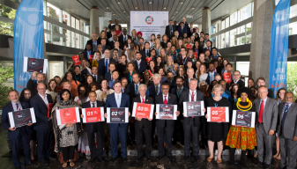

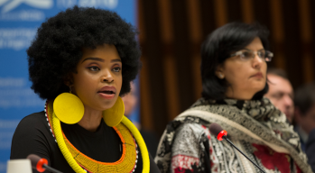
Six recommendations:
Heads of State and Government should take responsibility for the NCD agenda, rather than delegating it to ministers of health alone, as it requires collaboration and cooperation across many sectors.
Governments should identify and implement a specific set of priorities within the overall NCD and mental health agenda, based on public health needs.
Governments should reorient health systems to include NCDs prevention and control and mental health services in their universal health coverage policies and plans.
Governments should increase effective regulation, and appropriate engagement with the private sector, academia, civil society, and communities.
Governments and the international community should develop a new economic paradigm for funding actions on NCDs and mental health.
Governments need to strengthen accountability to their citizens for action on NCDs and simplify existing international accountability mechanisms.

Slide 29
Next steps
WHO's five-year strategic plan ("GPW13"):
Three flagships projects to scale up technical support to 30 priority countries
Promote mental health
Reduce cardiovascular diseases
Eliminate cervical cancer
Priority projects to support countries in implementing the best buys and good buys for NCDs
Projects to support national efforts to integrate actions to address NCDs and promote mental health into UHC and emergency and humanitarian responses
WHO for the UN General Assembly:
Track progress between 2018 and the fourth High-level Meeting on NCDs
Exercise WHO's leadership and coordination role in mobilizing global action on NCDs

Slide 30
Thank you
www.who.int/ncds

